Slide 1
Continuous Integration/Continuous Deployment
October 2017

Slide 2
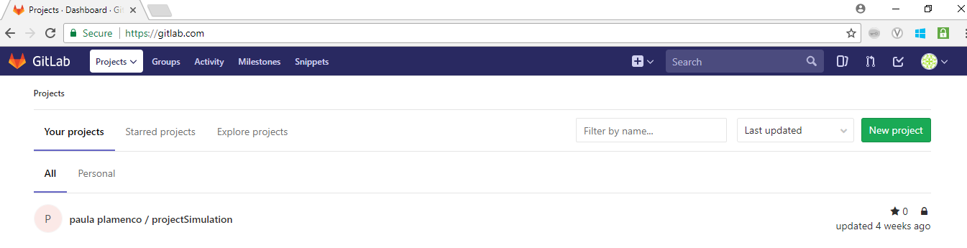
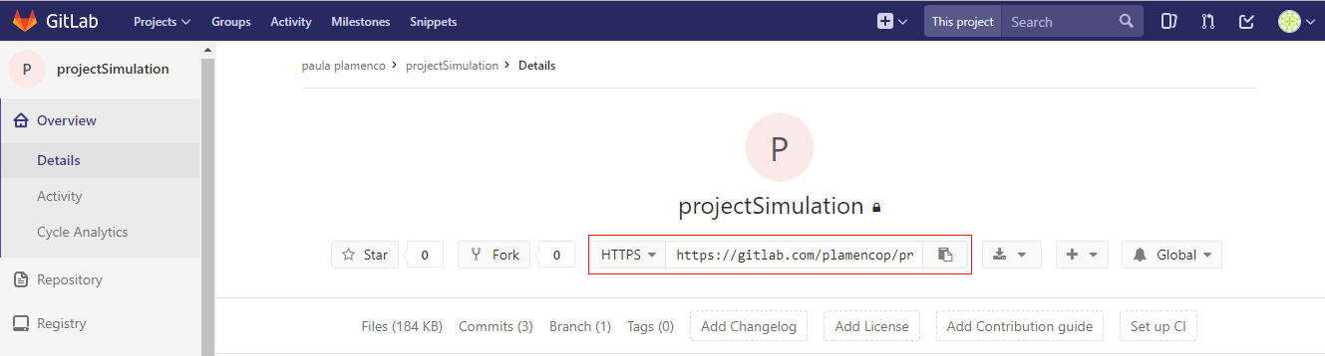
Continuous integration
Step 1. Create repository in GitLab
1. Click new project.
2. Copy the URL and clone the repository to your local. Push your web application code in the same repository.
Notes:
Push the created application to GitLab repository.

Slide 3
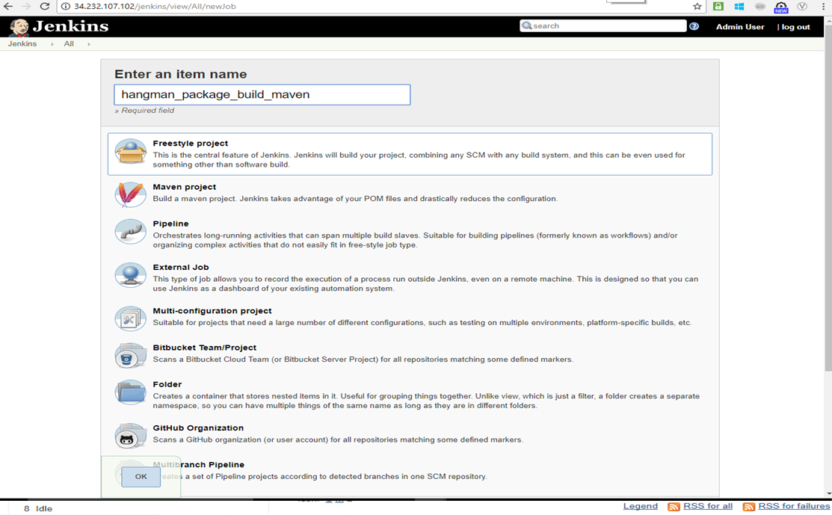
Continuous integration
Step 2. Create a freestyle project in Jenkins
1. Enter an item name.
2. Choose freestyle project.
3. Click ok.

Slide 4
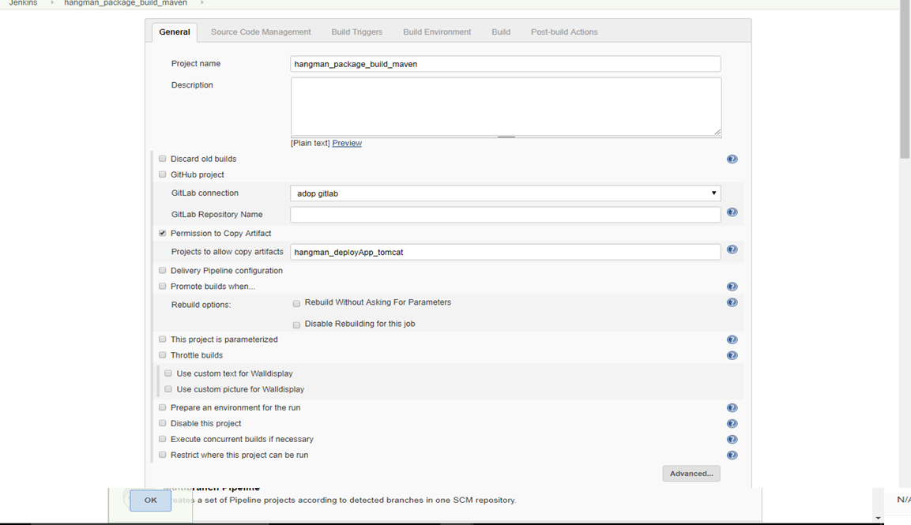
Continuous integration
Step 3. Configure Maven project – (Configure Project Options)
1. Enter project name.
2. Choose GitLab connection.
3. Proceed to SCM configuration.

Slide 5
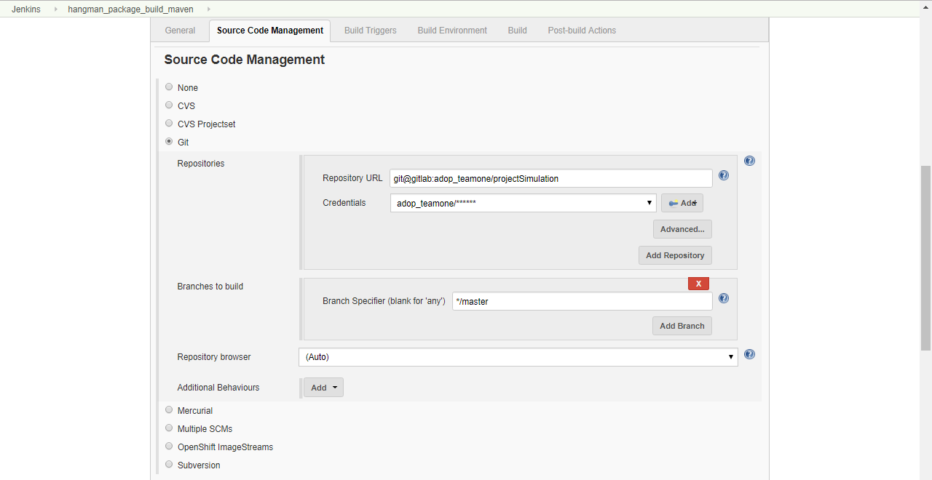
Continuous integration
Step 3. Configure Maven project – (Configure Source Code Management)
4. Choose Git. Input GitLab repository URL, credentials and branch to build.

Slide 6
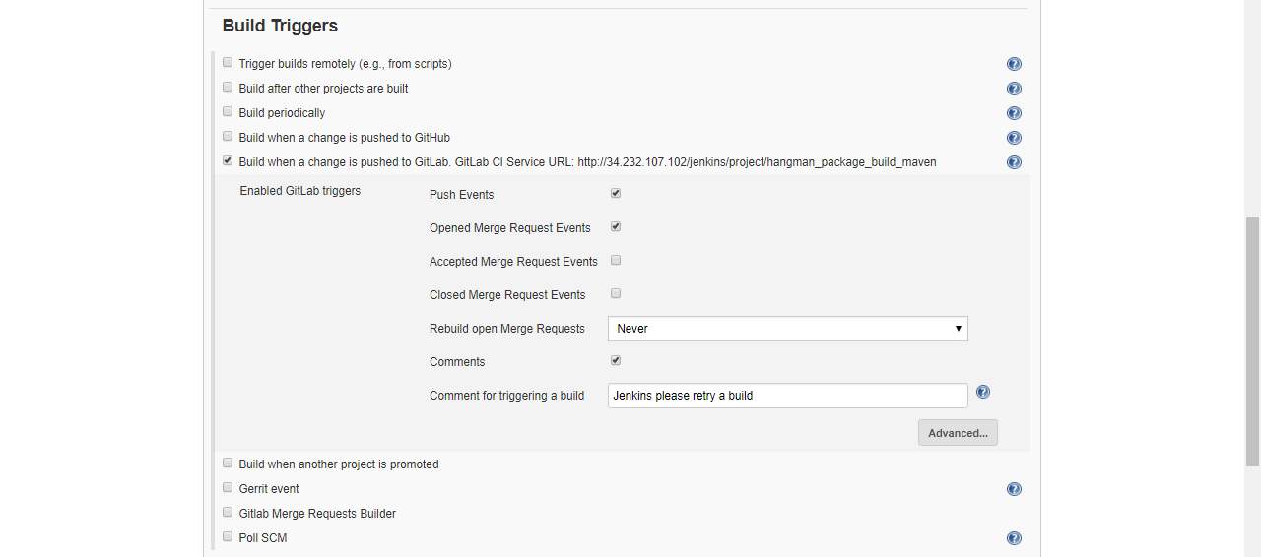
Continuous integration
Step 3. Configure Maven project – (Configure Build Triggers )
5. Tick build when a change is pushed to GitLab. To automatically trigger Jenkins maven job whenever changes is pushed to GitLab.

Slide 7
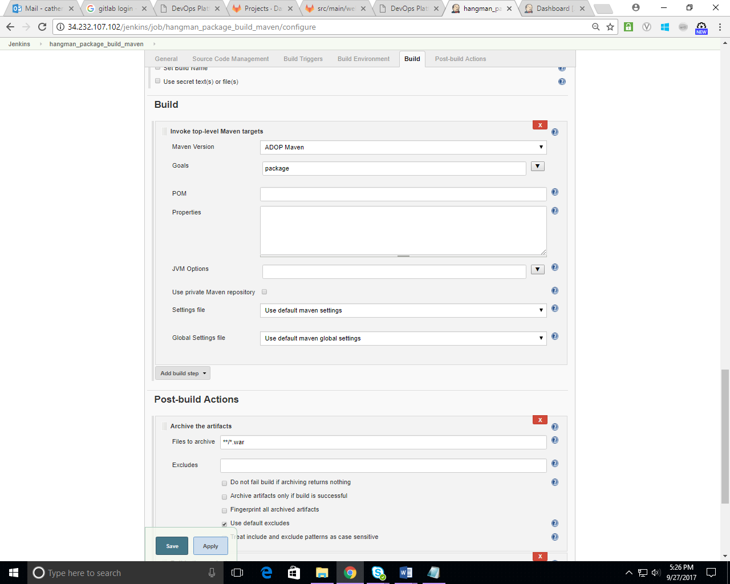
Continuous integration
Step 3. Configure Maven project – (Configure Build Step)
6. Invoke top-level Maven. Choose package.

Slide 8
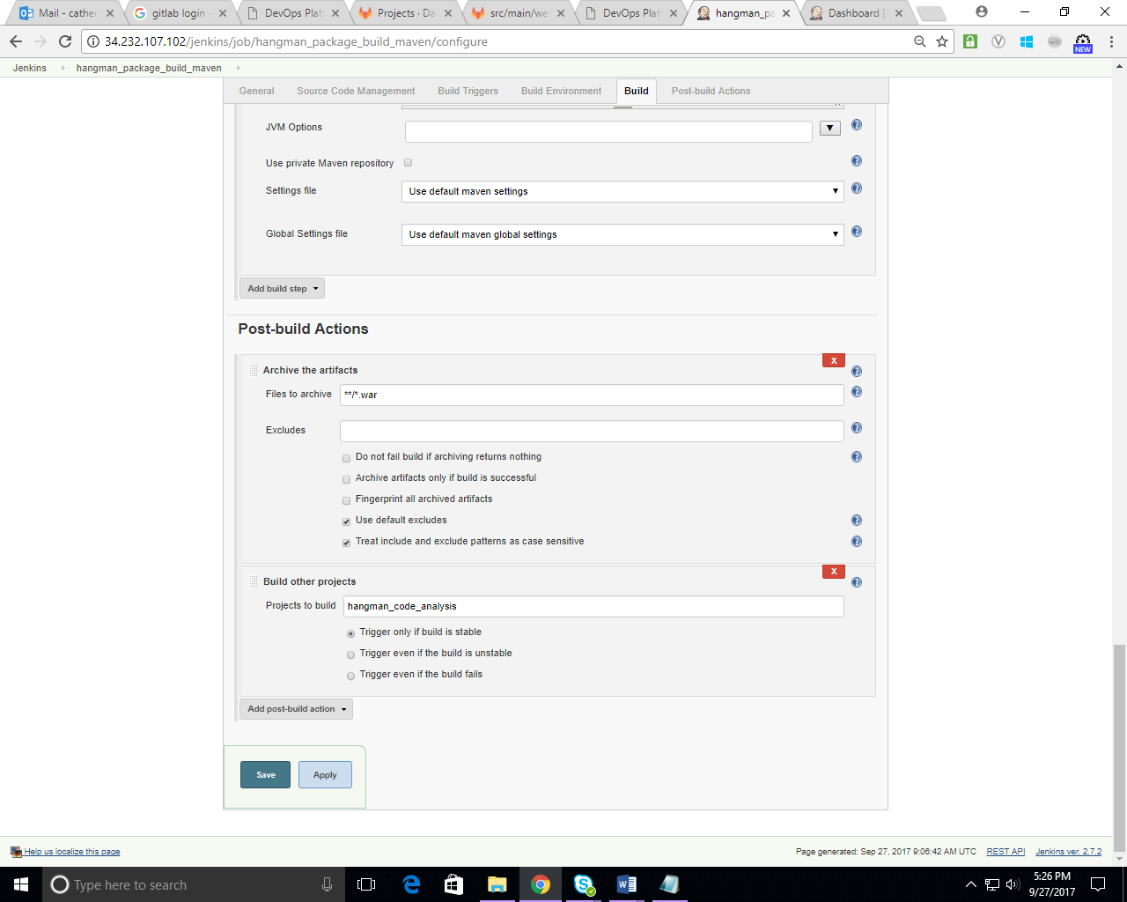
Continuous integration
Step 3. Configure Maven project – (Configure Post-build Action)
7. Archive the artifacts.
8. Add build other projects to trigger next job after the maven build is complete.

Slide 9
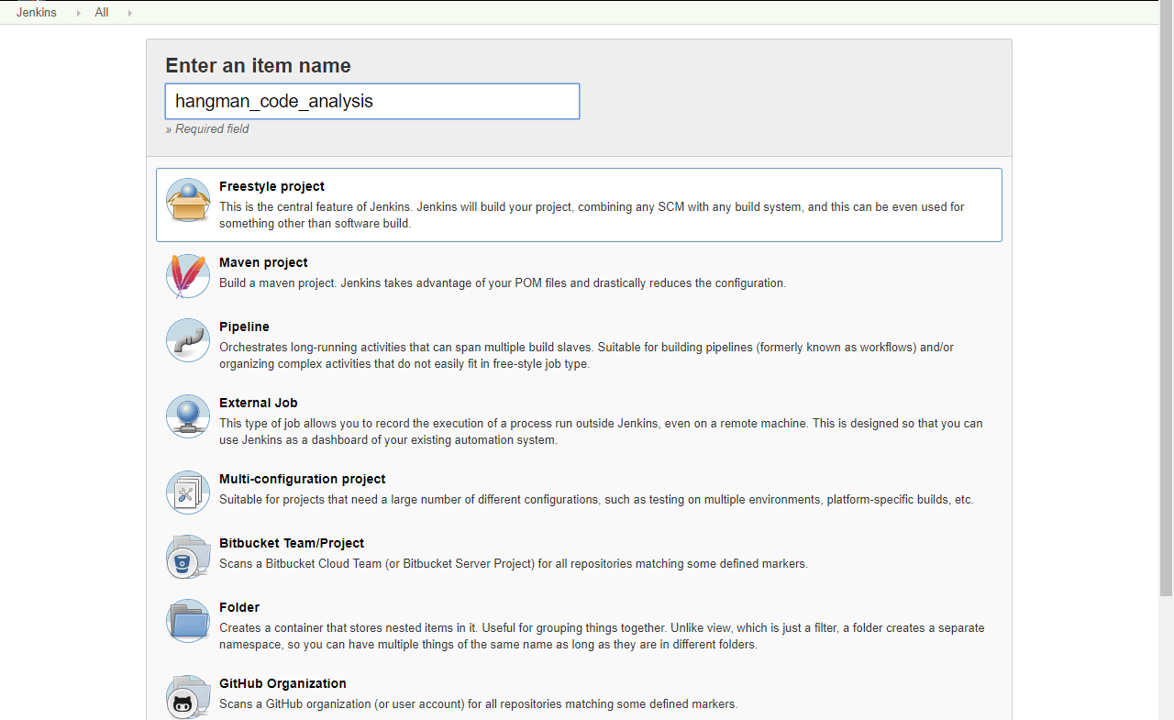
Continuous integration
Step 4. Create another freestyle project in Jenkins
1. Enter an item name.
2. Choose freestyle project.
3. Click ok.

Slide 10
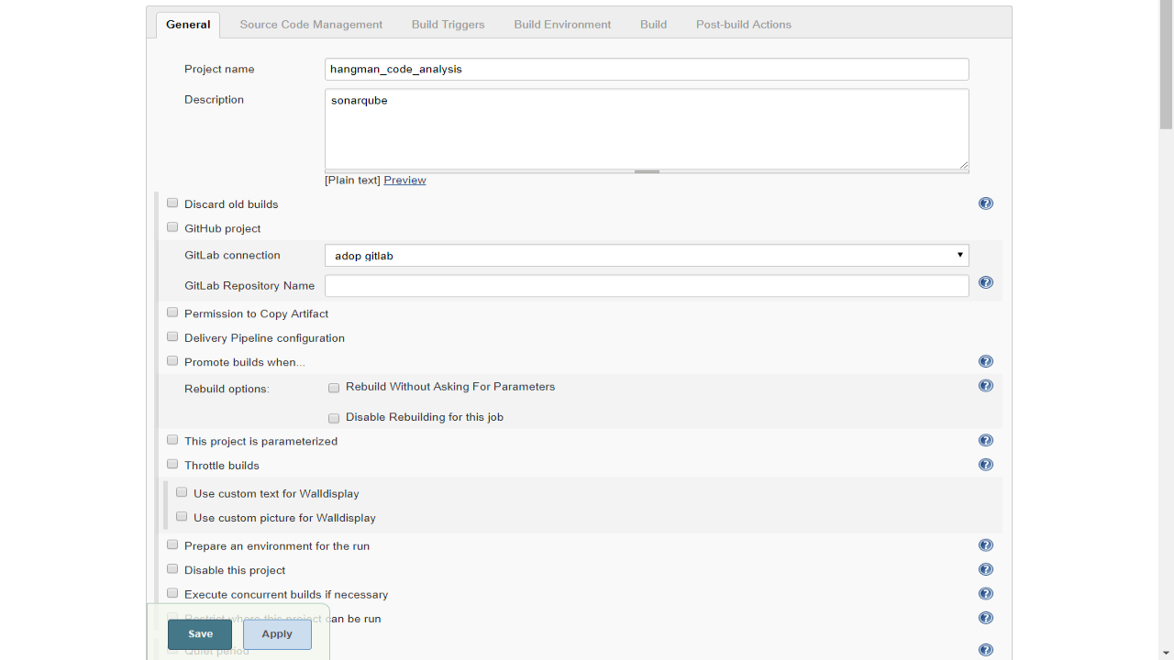
Continuous integration
Step 4. Configure SonarQube project – (Configure Project Options)
1. Enter project name.
2. Choose GitLab connection.
3. Proceed to SCM configuration.

Slide 11
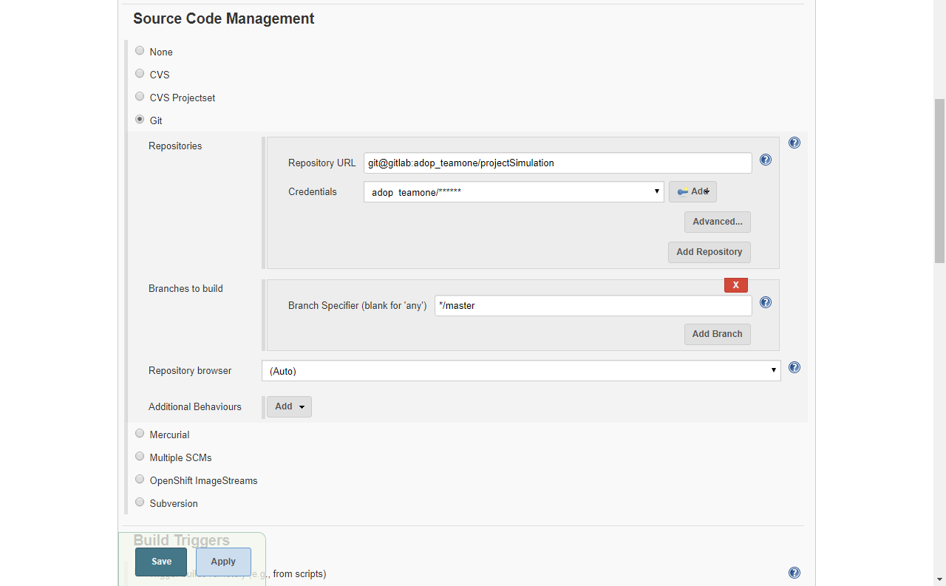
Continuous integration
Step 4. Configure SonarQube project – (Configure Source Code Management)
4. Choose Git. Input GitLab repository URL, credentials and branch to build.

Slide 12
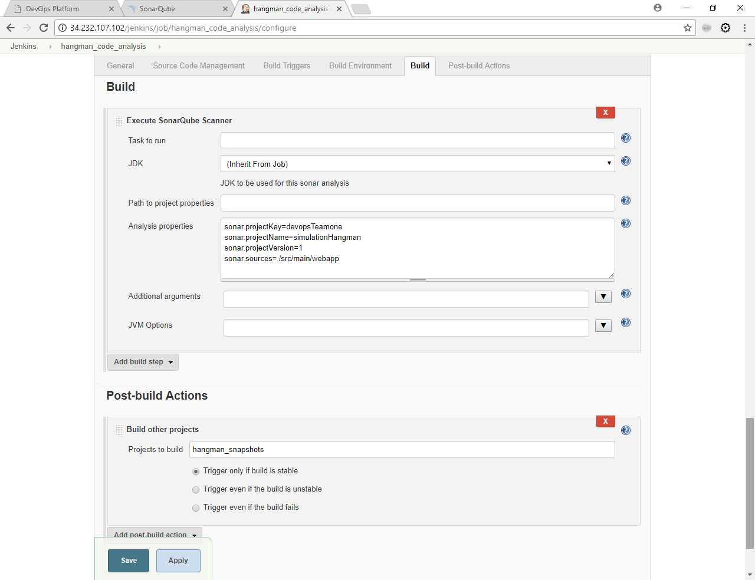
Continuous integration
Step 4. Configure SonarQube project – (Configure Build Step )
5. Execute SonarQube Scanner. Use (Inherit From Job) JDK for the sonar analysis.
6. Input Analysis Properties

Slide 13
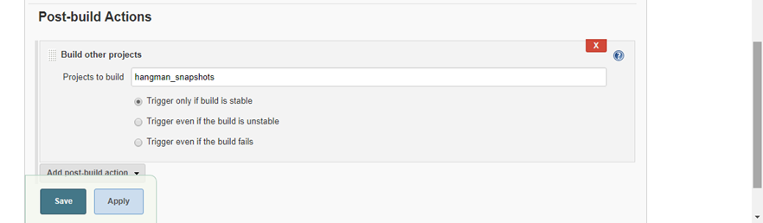
Continuous integration
Step 4. Configure SonarQube project – (Configure Post-build Action)
7. Add build other projects to trigger next job after the SonarQube build is complete.

Slide 14
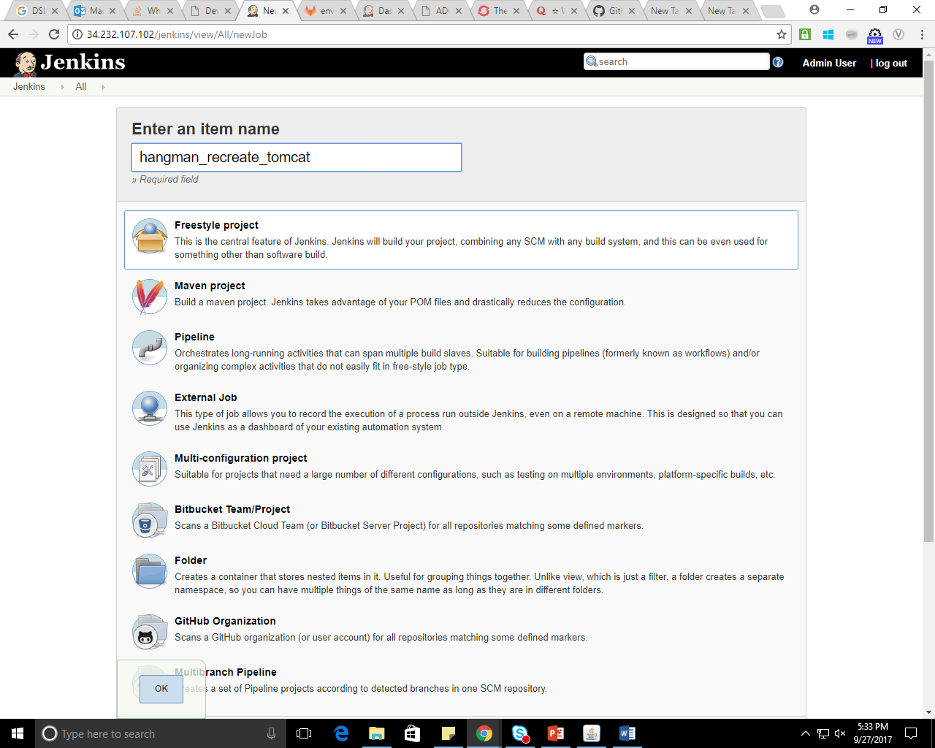
Continuous DEPLOYMENT
ANSIBLE : Step 1
Ansible Playbook Creation Guide:
http://docs.ansible.com/ansible/latest/playbooks.html
Create a Freestyle Jenkins Job

Slide 15
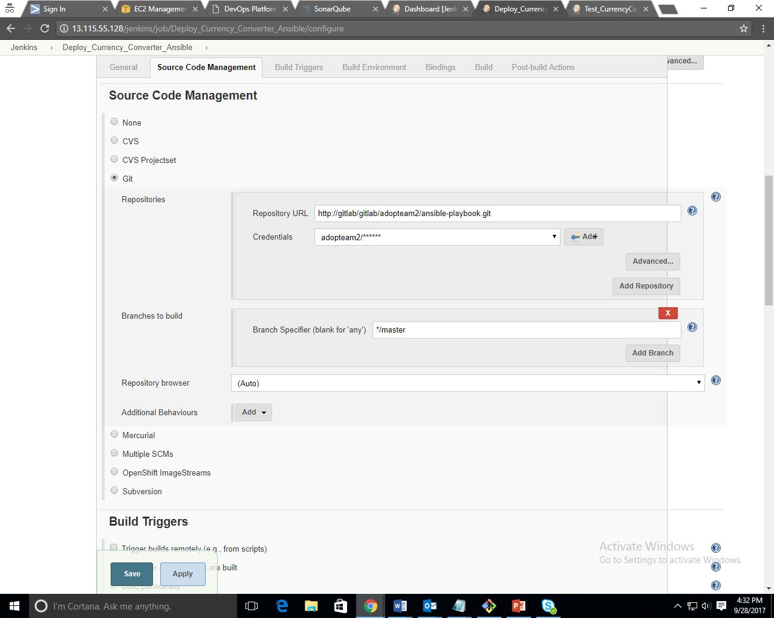
Continuous DEPLOYMENT
ANSIBLE : Step 2 ( Configuration )
Configure newly Created Job.
In Source Code Management,
Choose Git. Input GitLab repository URL, credentials and branch to build.
Notes:
You already have Tomcat up and running, you also have Jenkins up and running, have administrator privileges, and you have set up a job in Jenkins that produces a war file.
Edit tomcat-users.xml
In order for Tomcat to accept remote deployments, you have to add a user with the role manager-script. To do so, edit the file ../conf/tomcat-users.xml and add the following line:
<user username="deployer" password="deployer" roles="manager-script" />
1. Create a “free-style project“ Jenkins job.
2. Configure newly created job.
3. Scroll down to the bottom of the page to the “Post-build Actions”. Select the option “Deploy war/ear to a container” from the “Add post-build action” dropdown button. Fill in the new fields.
For the manager’s user name and password just copy over what you’ve entered in the tomcat-users.xml file.
4. Save the Configuration.

Slide 16
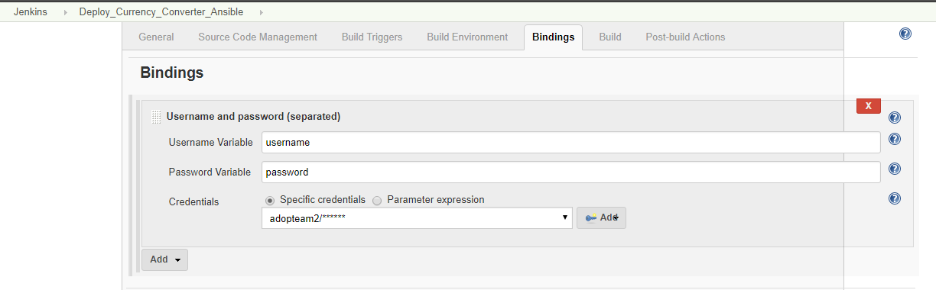
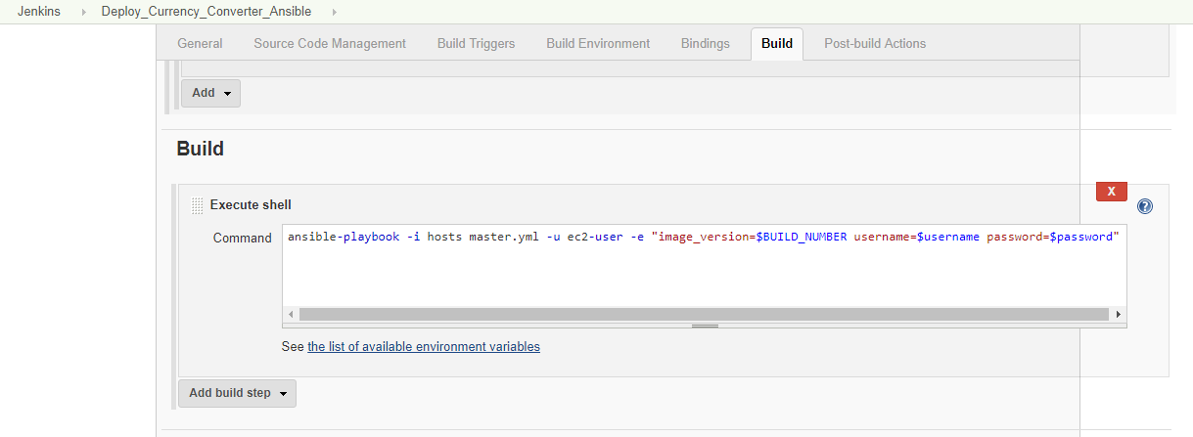
Continuous DEPLOYMENT
ANSIBLE : Step 2 ( Configuration )
Execute Shell Command to Run Ansible Playbook via Jenkins
Add build other projects to trigger next job after the Ansible job is complete.
Notes:
You already have Tomcat up and running, you also have Jenkins up and running, have administrator privileges, and you have set up a job in Jenkins that produces a war file.
Edit tomcat-users.xml
In order for Tomcat to accept remote deployments, you have to add a user with the role manager-script. To do so, edit the file ../conf/tomcat-users.xml and add the following line:
<user username="deployer" password="deployer" roles="manager-script" />
1. Create a “free-style project“ Jenkins job.
2. Configure newly created job.
3. Scroll down to the bottom of the page to the “Post-build Actions”. Select the option “Deploy war/ear to a container” from the “Add post-build action” dropdown button. Fill in the new fields.
For the manager’s user name and password just copy over what you’ve entered in the tomcat-users.xml file.
4. Save the Configuration.

Slide 17
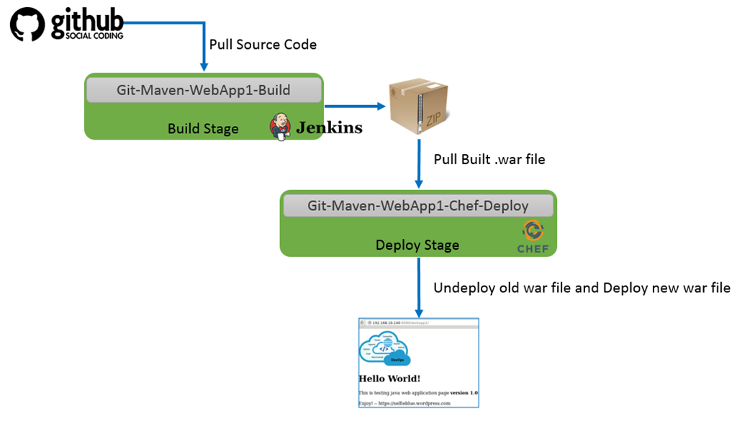
Continuous DEPLOYMENT
CHEF (You Can Use Either Ansible or Chef)
Chef can be use to undeploy old war file and Deploy new war file.

Slide 18
Continuous DEPLOYMENT
TOMCAT : Step 1
Create a Freestyle Jenkins Job

Slide 19
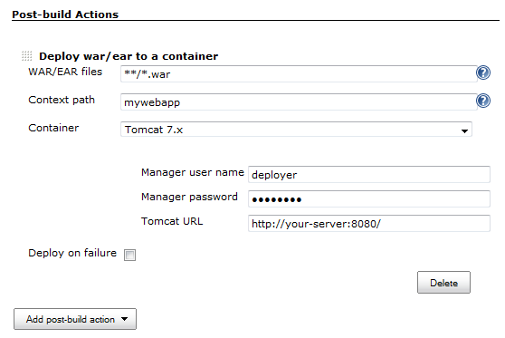
Continuous DEPLOYMENT
TOMCAT : Step 2 ( Configuration )
Configure newly Created Job.
Scroll down to the bottom of the page to the “Post-build Actions”. Select the option “Deploy war/ear to a container” from the “Add post-build action” dropdown button. Fill in the new fields.
Add build other projects to trigger next job after the tomcat job is complete.
Save the configuration.
.
Notes:
You already have Tomcat up and running, you also have Jenkins up and running, have administrator privileges, and you have set up a job in Jenkins that produces a war file.
Edit tomcat-users.xml
In order for Tomcat to accept remote deployments, you have to add a user with the role manager-script. To do so, edit the file ../conf/tomcat-users.xml and add the following line:
<user username="deployer" password="deployer" roles="manager-script" />
1. Create a “free-style project“ Jenkins job.
2. Configure newly created job.
3. Scroll down to the bottom of the page to the “Post-build Actions”. Select the option “Deploy war/ear to a container” from the “Add post-build action” dropdown button. Fill in the new fields.
For the manager’s user name and password just copy over what you’ve entered in the tomcat-users.xml file.
4. Save the Configuration.

Slide 20

Continuous DEPLOYMENT
SELENIUM : Step 1
Create a Freestyle Jenkins Job

Slide 21
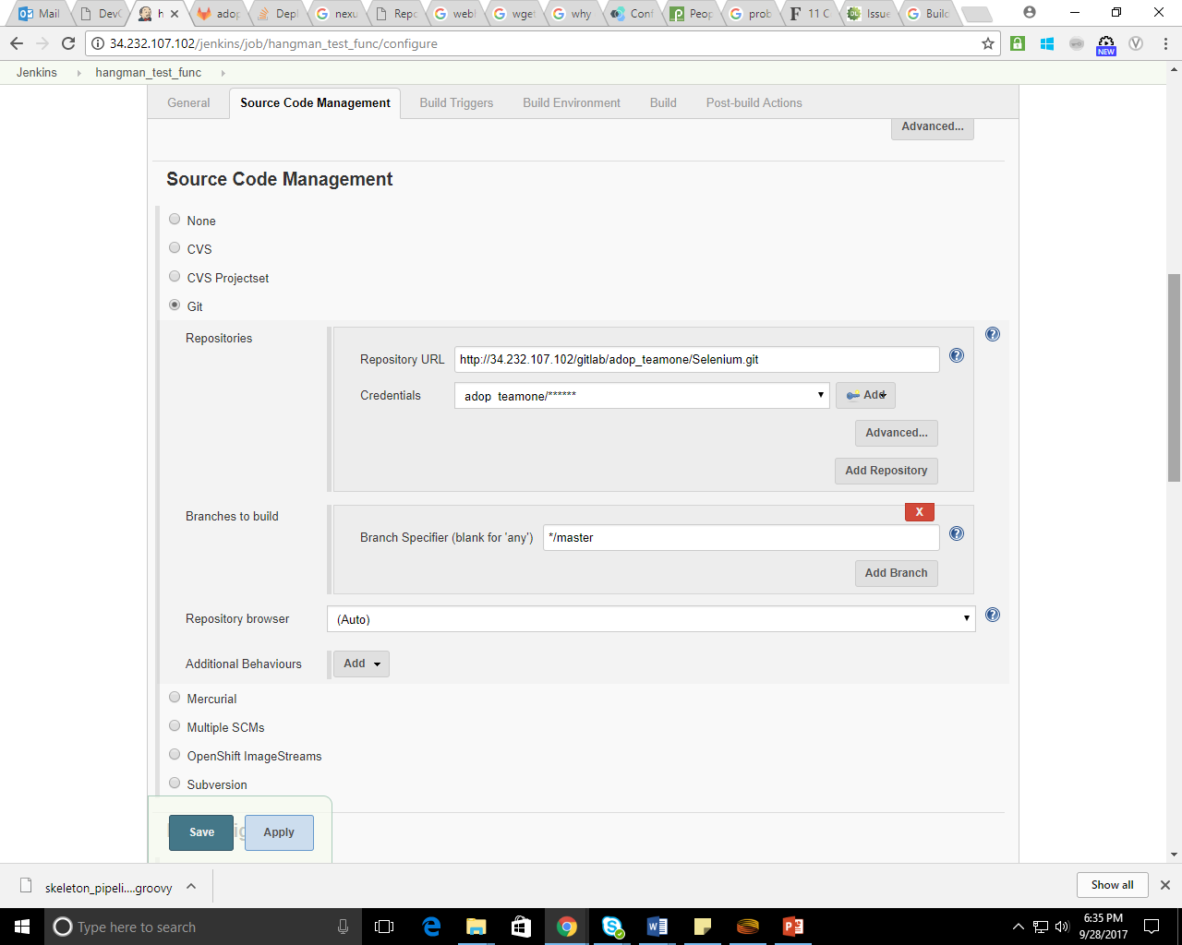
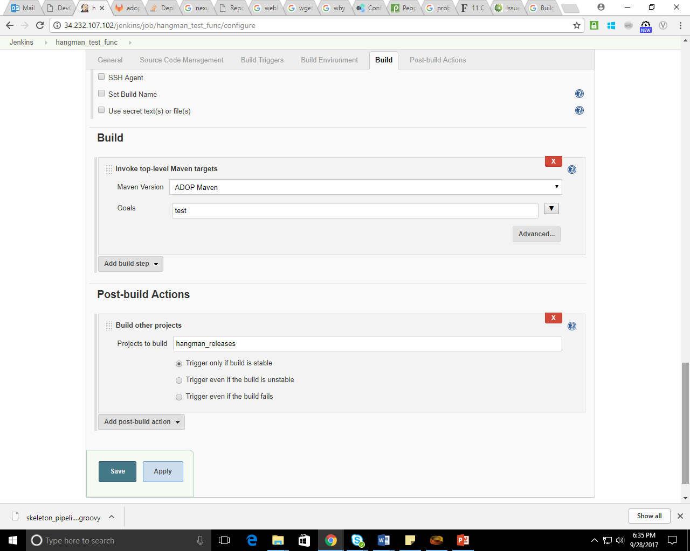
Continuous DEPLOYMENT
SELENIUM : Step 2 (Configuration)
Configure newly Created Job.
Reference your source code using any available version management system (Git, SVN, CVS or other).
Select ‘Invoke Top-Level Maven-targets’ from the Build dropdown box.
Enter ‘test’ as Goals.
Add build other projects to trigger next job after the tomcat job is complete.
Save the configuration.
.
Notes:
1. Create a “free-style project“ Jenkins job.
2. Configure newly created job.
3. Reference your source code using any available version management system (Git, SVN, CVS or other).
4. Select ‘Invoke Top-Level Maven-targets’ from the Build dropdown box.
5. Enter ‘test’ as Goals.
6. Save the configuration.

Slide 22

Continuous DEPLOYMENT
NEXUS : Step 1
Create a Freestyle Jenkins Job

Slide 23
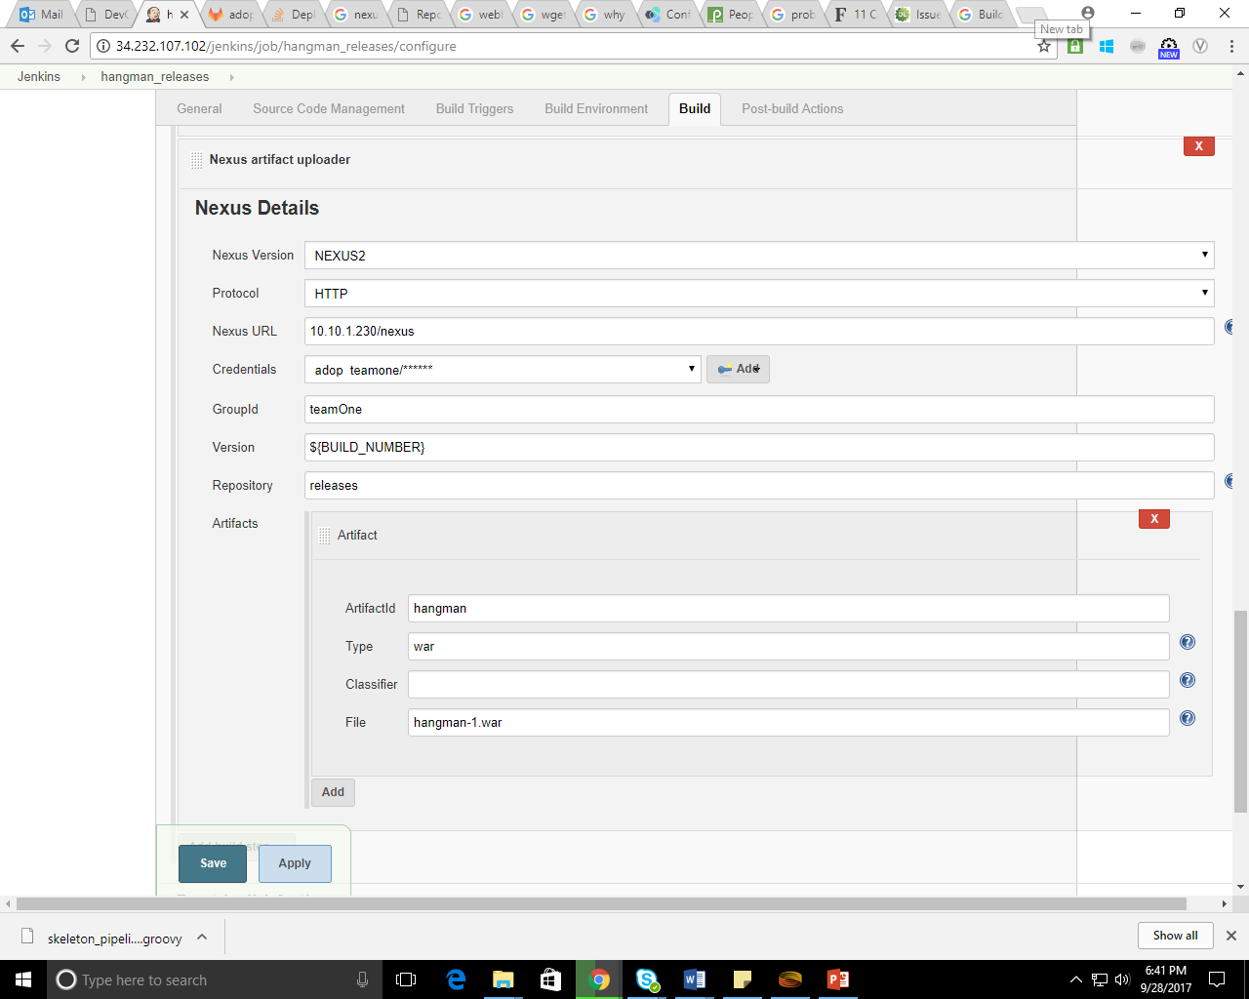
Continuous DEPLOYMENT
NEXUS : Step 2
Configure newly created job
In Nexus Artifact Uploader
fill Up the needed details
Save the configuration.
.

